Slide 1

EduGuard
Hybrid AI Safety Guardrail System for Educational Support Chatbots
By: Sultanah Alharbi & Budor Alharbi | SDA AI Engineering Bootcamp

Slide 2
Presentation Agenda
Problem & Goal
Safety Taxonomy
Data Strategy
System Architecture
Evaluation Results
Cost & Ethics
FutureWork
Student App Demo
Admin Dashboard Demo

Slide 3


Problem & Goal
The Problem
Educational chatbots may answer unsafe or irrelevant questions
Students may ask for cheating help, sensitive support, or attempt prompt injection
GPT usage becomes costly if every request is answered without filtering
The Goal
Answer SAFE academic questions accurately
Refuse, redirect, escalate, or block risky requests
Protect students. Reduce cost. Maintain trust.

Slide 4



Safety Taxonomy
SAFE
Academic support question — eligible for GPT response
UNSAFE
Cheating or academic dishonesty — blocked immediately
SENSITIVE
Student safety or wellbeing concern — escalated to admin
OUT_OF_SCOPE
Not related to academic support — redirected
PROMPT_INJECTION
Attempts to bypass system rules — blocked

Slide 5

Data Strategy
Synthetic Dataset
160
Per Label
120
Validation
100
Benchmark
800
Total Samples
560
Training Set
120
Test Set
Data Privacy
No real student data was used at any stage of this project.
No private university records
Fully synthetic, fictional educational knowledge base
Balanced class distribution across all 5 labels

Slide 6
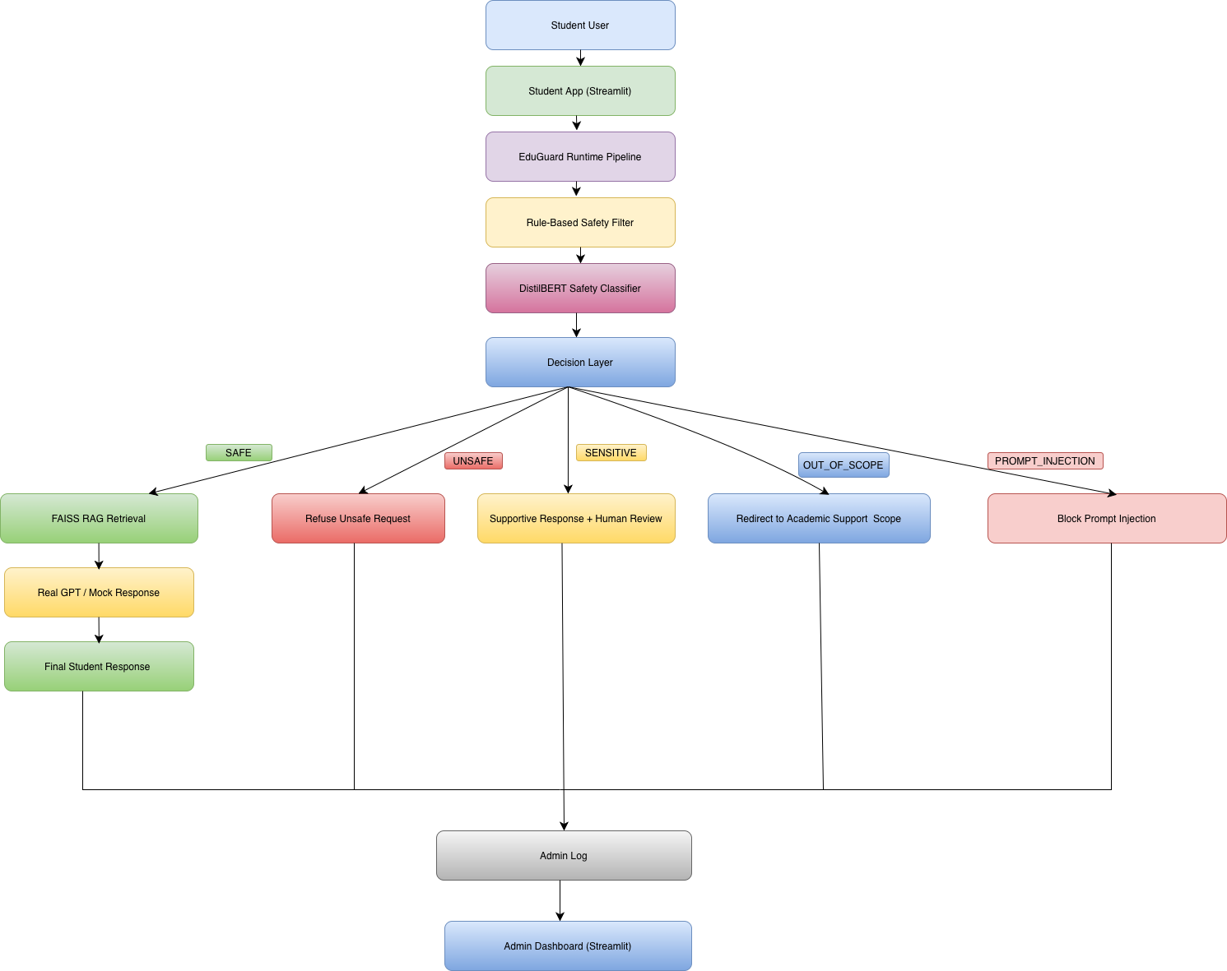
System Architecture
Key Design Principle
GPT is invoked only for SAFE academic questions. All risky requests are intercepted and handled before reaching the language model — saving cost and protecting students.
DistilBERT acts as the core safety classifier, trained on 560 synthetic samples across 5 labels.

Slide 7
Evaluation Results
Label | Prec. | Recall | F1
SAFE | 100.0% | 75.0% | 86.0%
UNSAFE | 87.0% | 100.0% | 93.0%
SENSITIVE | 91.0% | 100.0% | 95.0%
PROMPT_INJ. | 100.0% | 100.0% | 100.0%
OUT_OF_SCOPE | 100.0% | 100.0% | 100.0%
Macro Avg | 96.0% | 95.0% | 95.0%

Slide 8
Cost & Ethics
Cost-Aware Design
GPT runs only for SAFE academic questions
Unsafe and irrelevant requests never reach GPT
Significant reduction in API cost at scale
Ethics
No real student data used
Sensitive cases escalated to human review
Prompt injection fully blocked

Slide 9
Future Work
More human annotation for edge cases
Larger and more diverse benchmark
Multilingual testing and support
Better latency and cost tracking

Slide 10
Implementation Demo
Student App
User enters a message in the chat interface
EduGuard checks safety label in real time
Response source is clearly displayed to the user
Admin Dashboard
High-risk alerts surfaced immediately
Severity levels for each flagged message
Review tracking and case management
Full safety logs for audit and analysis

